Slide 1
Chapter 9
Application basics

Slide 2
Selecting application software
Application software performs a specific job or task
Word Processors – used for writing letters or reports
Spreadsheets – used for working with numbers and doing math
Databases – used for storing and finding information
Presentation Graphics – used for creating slide shows
Desktop Publishing – used for creating printer-ready publications such as brochures, newsletters, and invitations
Telecommunications - used for Internet and e-mail

Slide 3
Stand-alone Programs
Software that specializes in one task
Does not require anything else to run other than an OS
Examples
  Word
  Photoshop
  Auto-Cad
  Oracle

Slide 4
Integrated Software
Productivity software
Combine the basic feature several applications into one package
  Examples
    Microsoft Office
    Corel WordPerfect Office
    Adobe Creative Suite

Slide 5
Trends
SAS (Software as a Service)
  Applications are made available online
    Office 365
    Google Docs
    iWORK
Pervasive Computing
  Voice Activation
    Alexa
    Cortana

Slide 6
Obtaining application software
Minimum System Requirements
  Hardware and software specs for the installed software to work
What to look for
  Mac or PC
  CPU Speed
  OS type (Linux, Windows, OSX)
  RAM
  HD Space
  Any special equipment IE DVD drive

Slide 7
Obtaining Commercial Software or proprietary software application software
Copyrighted software
Buy before you use it
Signed agreement to use the software
Gain access to the software but not the code
Also called closed-source software

Slide 8
Obtaining application software
Shareware
Proprietary software that you can use before you buy it
Usually only last a limited amount of time
If you decide to keep it, you must pay for it to get a code
You can copy it and share with friends

Slide 9
Obtaining application software
Freeware
Free copyrighted software
Can use it as long as you don’t resell it

Slide 10
Obtaining application software
Open-Source Software
Might still have to pay for the software like propriety software
Unlike Closed Source software the source code is available
  Open Office

Slide 11
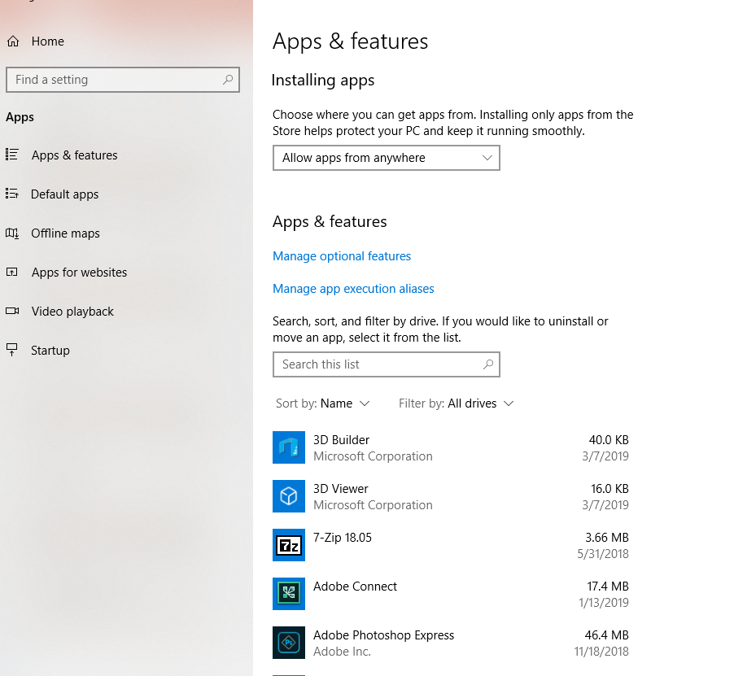
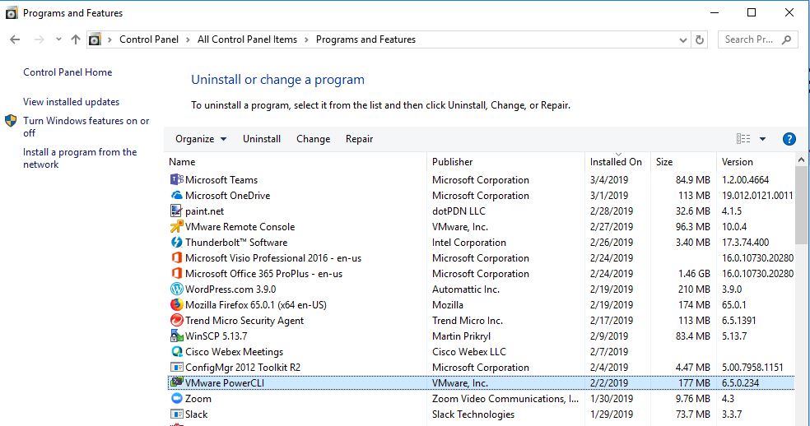
Installing, Reinstalling and Uninstalling programs
Applications must be installed on a computer before it can be used (SORTA)
Programs come with installation or setup program that prompts you to load the software onto the computer
Delete \ Uninstall
  Special program to remove all pieces are parts of the installed program (SORTA)
Repair
  Used if program is not working correctly.
  Not an option for every program

Slide 12
Web Apps
Web Apps
  Gmail
  Yahoo Mail
  Facebook
  Twitter
Productivity
  Google Docs
  Office 365
  iCloud
CRM (Customer Relationship Management)

Slide 13
Using software legally
Buying software comes with a software license
Allows the user to install and use the software
Sometimes entitles the buyer to receive free or reduced cost for support and updates
Types of License
  Single-User (1 copy)
  Single-seat License (Install on Single Computer)
  Volume or Site License ( Install on multiple computers)
  Per Seat VS Concurrent

Slide 14

Software piracy

Slide 15
Getting Started with applications
Quick Access Tool Bar
Title Bar
Maximize
Close
Home Tab
Help
Ribbon
Minimize

Slide 16
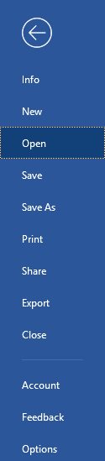
Getting Started with applications
Info Displays details or properties, about the file
New creates a new file
Open retrieves a saved file
Save stores changes to a file
Save As stores a copy of a file
Print displays options for previewing or printing the file
Close closes the current file
Options displays customization options

Slide 17
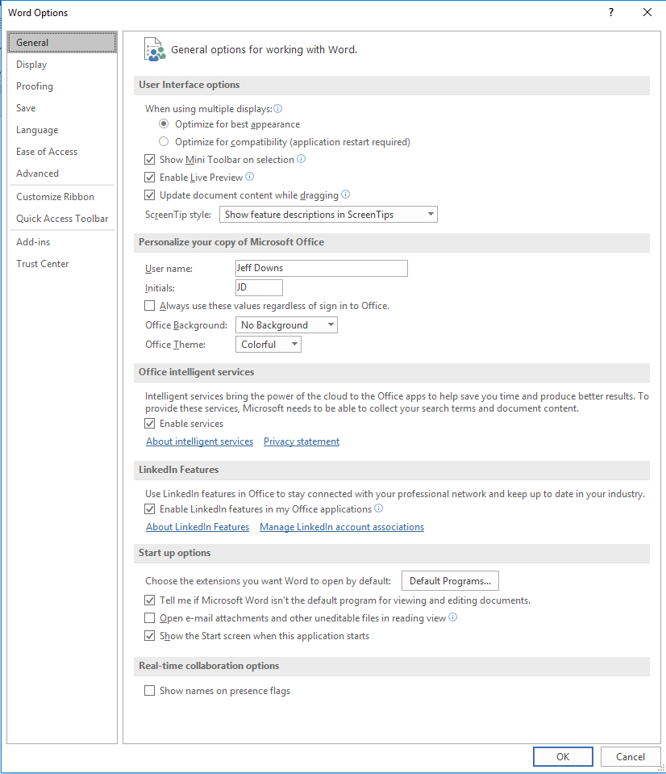
Getting Started with applications

