Slide 1
Chapter 8
Understanding system software

Slide 2
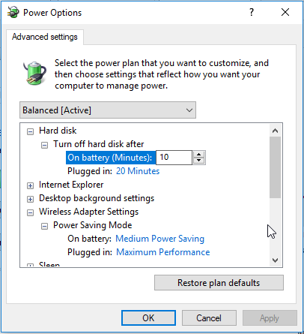
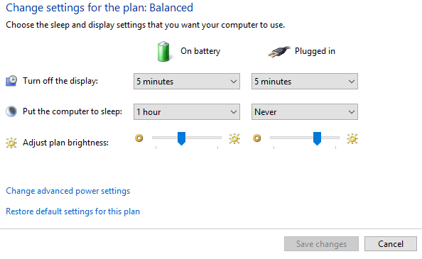
power options
Setting options allows you to control how the computer is configured when either on battery or plugged in
More critical when you are using a tablet or laptop device

Slide 3
Desktop changes
Changing background images
Changing screensaver
Adding or removing desktop icons
Taskbar display or hide
Ease of Access

Slide 4
User accounts
Way of protecting data
Sets a way to who can access the computer
Assigned username and password by system administrator

Slide 5
User rights
Access rights what files a user can access
Installation rights for software
Installation rights for hardware installs
Configuration rights on who can do what to computers
Group policy settings
  Can be set for users or computers
  Set at a global scale not at the individual computer level

Slide 6
Logging on Off
Log on to gain access to the computer and files and folders
Should log off when you are done
Switch users is also a option

Slide 7
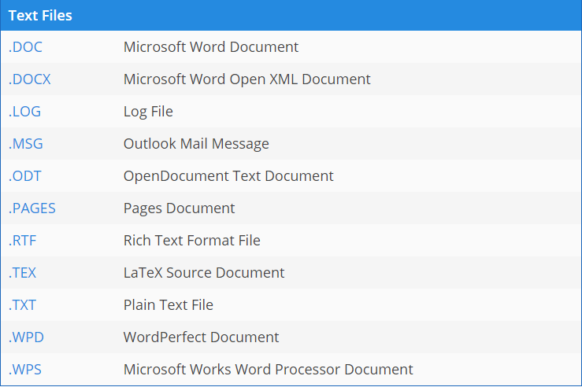
Files and Folders
Extensions

Slide 8
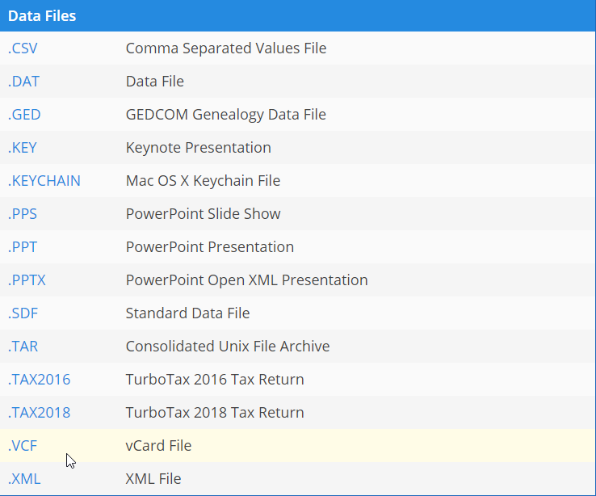
Files and Folders
Extensions

Slide 9
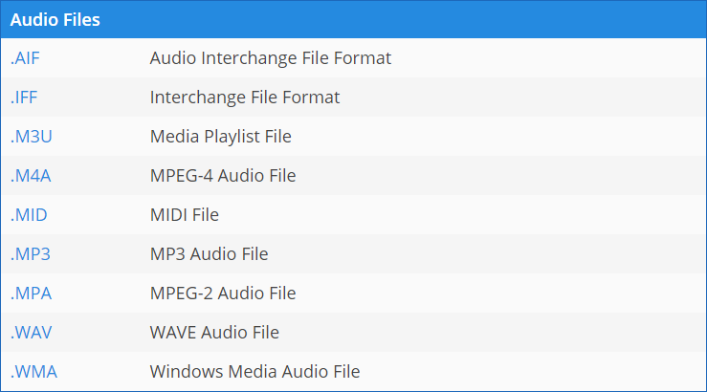
Files and Folders
Extensions

Slide 10
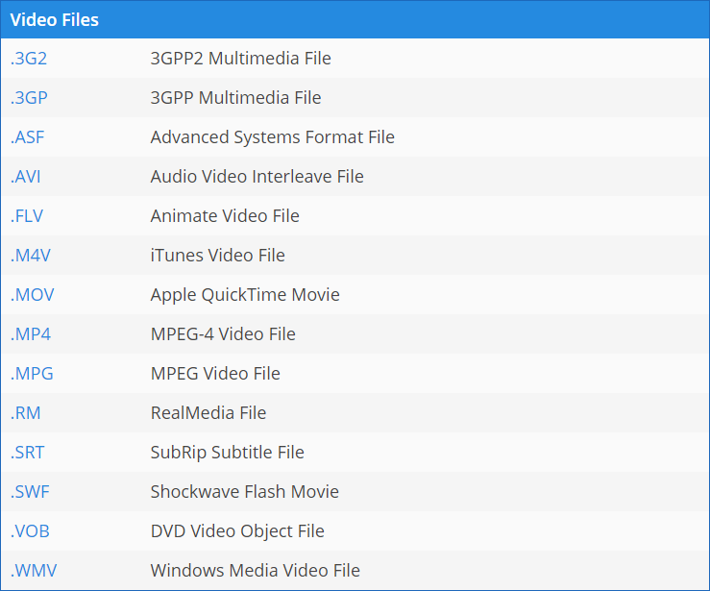
Files and Folders
Extensions

Slide 11
Naming Files
Keep them organized
Keep them descriptive
  2013_Annual_Report versus Report
Most let you name up to 255 characters

Slide 12
Sharing files
Cross-Platform Compatibility
  Ability to open, edit and save files on different platform ie MAC to Windows
  Must have same software package on it in a compatable version
  Application must allow its file formats to be shared across different OS

Slide 13
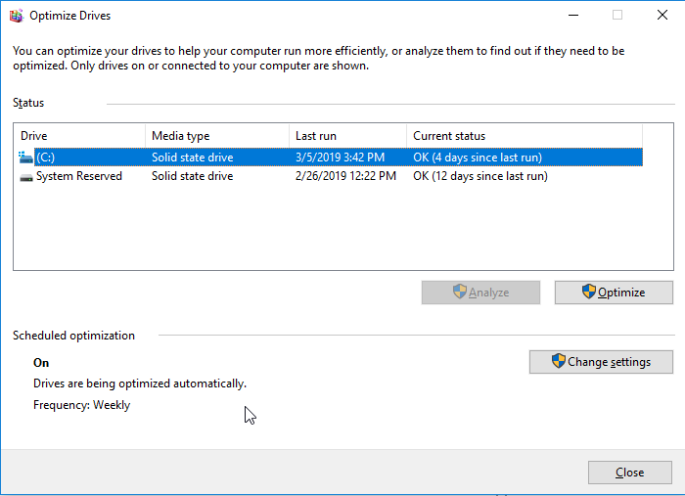
Disk management
Disk Defragmenter
  As files are saved and deleted they can be put on different sections of the disk
  Reduces disk efficiency

Slide 14
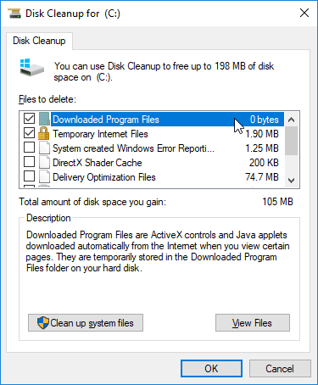
Disk cleanup
Used to delete files not required to run

Slide 15
Virus detection \malware
Can be infected through email, programs or files
Malware – software designed to damage or disable your computer
Virus – type of malware that can replicate or copy itself
Should always update or check for updates daily
Antivirus Software
  Intrusta
  Nortan Anti Virtus
  McAfee
  Bullguard
  Kaspersky
  Avast
  AVG
  Avira

Slide 16
Malware
McAfee
Malwarebytes
Norton
Avast
AVG
TrendMicro

