Slide 1
Chapter 6
Understanding how data storage works

Slide 2
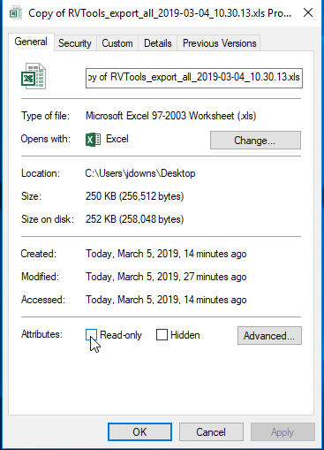
Data protection
Set a read-only property so that data may be read but not changed
Definition of Property
  Piece of data sometimes called metadata, attached to or associated with a file program or device

Slide 3
Data protection
Types of Properties
  Name
  Type
  Storage Location
  Size

Slide 4
Storage trends
Common Storage-Device Problems
  Slow Retrieval
    Tape Drives – must start from the beginning of the tape and search
  Data Decay
    Loss of information resulting from the gradual wearing down of the storage medium
      Due to environmental conditions
      Can start to loose data as soon as 5 years
      Can loose data if exposed to strong magnetic field
  Friction
    Heat causes the tape to stretch

Slide 5
Storage trends
Data Integrity
  Stored information is usable and available in the location in which you expect to find it
Ways to obtain it
  RAID (Redundant Array of Inexpensive Disk)

Slide 6
Enterprise Storage
Network Computers
  LAN (Local Area Network)
  Linked together by a cable or wireless medium
  Can share enterprise storage systems

Slide 7
New and future technologies
Cloud Computing and Virtualization
  Cloud Computing
    Make computers more efficient by using centralized storage and memory and processing
    Uses the Internet and central remote servers to host data and applications
  Virtualization
    Physical storage is pooled from multiple network storage devices into what seems to be one single storage device managed from a central console
    SAN (Storage Area Network)

Slide 8
New media
Magnetic Media
  Currently holds 10 gig per square inch
  Future holds 1 TB per squire inch
Optical Media
  Currently holds up to a few gig
  Future will hold 1 TB
Holographic Media (HDSS)
  Stores images called holograms on optical cubes
  Hold more than 1 TB

