Slide 1
Chapter 2
Understanding Computers

Slide 2
Review

Slide 3
Parts to a whole
Input
Processing
Output
Storage

Slide 4
Commands?
Tells a computer what to do
  Print Document
  Close Window
  Save Document

Slide 5
Input
Keyboard
  Basic
Speech Recognition Software
  Dragon Naturally Speaking
Handwriting Recognition Software
  Use of a stylus

Slide 6
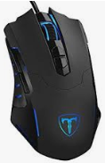
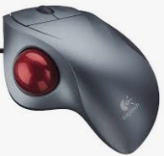
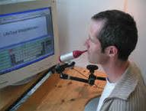
Other Types of input
Mouse
  Moves a pointer around the screen and click on command or sections of a document
  Input pictures into document
Adaptive Technologies
Trackball Mouse

Slide 7
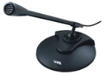
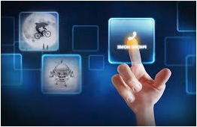
Other Types of Input
Touch Screen Monitors
Microphone
  Input sounds into document

Slide 8
Processing devices
Motherboard
  CPU
    Multiprocessing cores
  RAM
    Random Access Memory
  ROM
    Read-only Memory
  Video Cards

Slide 9
Processing devices - CPU
The central processing unit (CPU) is the unit which performs most of the processing inside a computer. To control instructions and data flow to and from other parts of the computer, the CPU relies heavily on a chipset, which is a group of microchips located on the motherboard.

Slide 10
Processing Device – RAM\ROM
ROM (Read Only Memory)
  Read-only memory (ROM) is a type of storage medium that permanently stores data on personal computers (PCs) and other electronic devices. It contains the programming needed to start a PC, which is essential for boot-up; it performs major input/output tasks and holds programs or software instructions.
  Because ROM is read-only, it cannot be changed; it is permanent and non-volatile, meaning it also holds its memory even when power is removed. By contrast, random access memory (RAM) is volatile; it is lost when power is removed.
  There are numerous ROM chips located on the motherboard and a few on expansion boards. The chips are essential for the basic input/output system (BIOS), boot up, reading and writing to peripheral devices, basic data management and the software for basic processes for certain utilities.
RAM (Random Access Memory)
  RAM (Random Access Memory) is the hardware in a computing device where the operating system (OS), application programs and data in current use are kept so they can be quickly reached by the device's processor. RAM is the main memory in a computer, and it is much faster to read from and write to than other kinds of storage, such as a hard disk drive (HDD), solid-state drive (SSD) or optical drive.

Slide 11
Processing Device
Video Card
  General-purpose computing on graphics processing units (GPGPU, rarely GPGP) is the use of a graphics processing unit (GPU), which typically handles computation only for computer graphics, to perform computation in applications traditionally handled by the central processing unit (CPU)

Slide 12
Operating system
An operating system is a software which performs all the basic tasks like file management, memory management, process management, handling input and output, and controlling peripheral devices such as disk drives and printers.
Examples
  MAC
  Windows
  Android
  Linux

Slide 13
Basic programming concepts
Procedural
  Step by Step instructions to tell a computer what to do.
    C
    Fortran
    Pascal
    Basic
Object Oriented Programming
  Provides rules for creating and managing object
    Java
    Alice
    Python
    VBScript
C++ Uses both

Slide 14
Basic programming concepts - Continued
Compilers
  Translate source code into binary format so the computer = object code
Interpreters
  Able to translate the source code into action for the computer

Slide 15
Digital computing
Binary 1’s and Zero’s

Slide 16

Grouped and individual computers - Supercomputer
Home VS Work
Supercomputer
  Scientific Computers
  Perform millions of calculations per second
  $

Slide 17
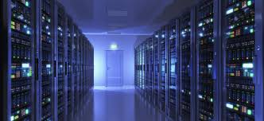
Group and Individual Computers – continued - Mainframe
Government
Large Agencies
Banks
Can be accessed by multiple individuals

Slide 18
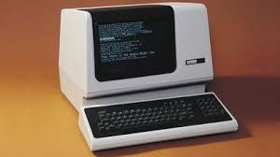
Group and Individual Computers – continued -mainframe

Slide 19
Group and Individual Computers – continued - servers
Government
Large Agencies
Banks
Can be accessed by multiple individuals
Stores programs
Files

Slide 20
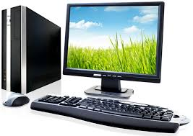
Group and Individual Computers – continued - servers

Slide 21
Computers for individuals
Workstations
  Higher end stations for engineers, digital designers
Personal Computer
  Home use
Tablet Computers
Smart Phones
Smart Devices
PDA
Wearable devices

