Slide 1
Chapter 1
What is a computer

Slide 2
Lesson 1-1

Slide 3
Definition of a computer
A machine that changes information from one form into another performing four basic actions

Slide 4
Information processing cycle
Input
Processing
Output
Storage

Slide 5
input
Is the raw information or data that is entered into the computer

Slide 6
Examples of input
Letters
Numbers
Color Photographs
Video
Songs

Slide 7
Types of Input devices
Keyboard
Digital Camera
Digital Video Camera

Slide 8
Bits and bytes oh my !!!!
Bits of DATA
  Bits is short for binary digit
    Only values are 0 or 1
Bytes
  Every picture, letter or number are entered into a computer as a combination of bits
  Bits are added into groups 8 or more
  Each group of bits are called Bytes

Slide 9
Examples of Bytes (Letters or Numbers)
A
  01000001
1
  00110001
Are you enjoying the class
  01000001 01110010 01100101 00100000 01111001 01101111 01110101 00100000 01100101 01101110 01101010 01101111 01111001 01101001 01101110 01100111 00100000 01110100 01101000 01100101 00100000 01100011 01101100 01100001 01110011 01110011

Slide 10
Color BYTES
RBG (Red, Blue, Green)
Represented by 6 Hexadecimal Value
  First 2 Read
  Second 2 Blue
  Last 2 Green

Slide 11
RBG Examples
Color |  | Hexadecimal (#RRGGBB)
Black |  | #000000
White |  | #FFFFFF
Red |  | #FF0000
Green |  | #00FF00
Blue |  | #0000FF
Yellow |  | #FFFF00
Cyan |  | #00FFFF
Magenta |  | #FF00FF

Slide 12
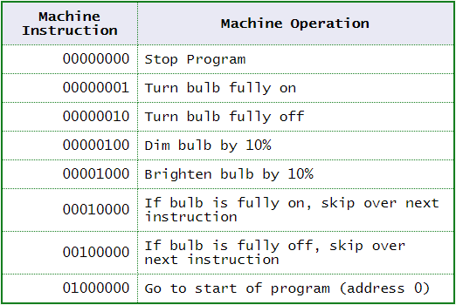
Processing
Coded Instructions
  Coded information that is written to tell the program what to do based on input from user or program
Machine Language

Slide 13
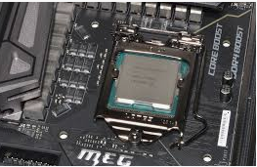
Processing Speed
Can process millions of operations every second
Example
  AI (Artificial Intelligence)
  Video Games
  Video
  Video Editing
  Picture Editing

Slide 14
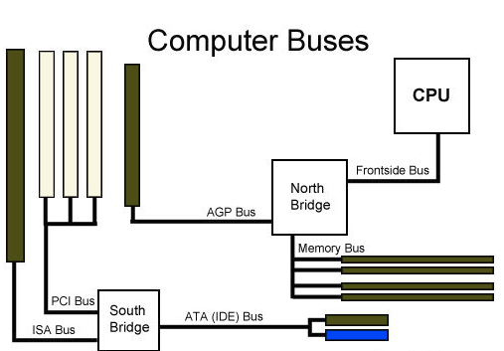
Processing Speed – what makes it fast
CPU (Computer Processor Unit)
Cache ( RAM or Storage)
Memory (RAM, Radom Access Memory)
BUS Speed
Hard Drive (Solid state or Spinning Disk)
Video Card
OS (Operating System)
Software

Slide 15
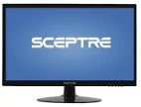
Output (What happens after processing)
Programs tells to add 2 numbers
Crop image of picture
Add transition to powerpoint
Or to put it simple
For ever in(PUT) there is an out(PUT)

Slide 16
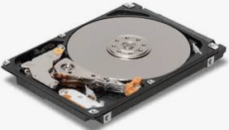
Storage
Where the computer saves what you have done
Stores data in RAM temporally

Slide 17


Places for storage
Local Storage (Hard Drive)
Flash Storage (Thumb Drive, USB Drive)
External Hard Drive
Cloud Storage (Google Drive, One Drive, Drop Box, Box, iCloud)
CD-Rom (Old School, still used some)
Floppy Disk (Old School)
Zip Drives (Old School)

Slide 18





Who makes what
Google
Dropbox
iCLOUD
Onedrive
BOX

Slide 19
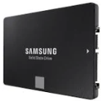
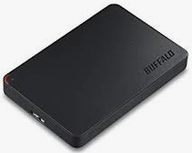
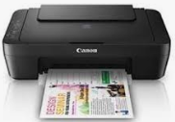
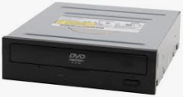
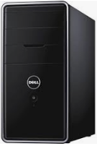
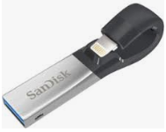
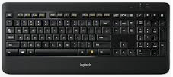

Putting it all together
Output
Processing
Input
Storage

Slide 20
Lesson 1-2
Hardware

Slide 21
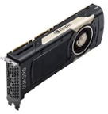

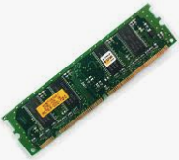
Hardware

Slide 22
Processing Devices
CPU (Central Processing Unit)
  Arithmetic and Compare Data

Slide 23
Primary Storage
RAM Random Access Memory
  Volatile Memory
  Place for data temporally stores data
  Gone after system shutdown\reboot

Slide 24
Secondary Storage

Slide 25
Secondary Storage capacity
From 256 megabits – 30 Terabytes
  1 bit = .001 kilobit
  1024 bits = .128 kilobytes
  1024 kilobytes = 1 megabyte
  1024 megabytes = 1 gigabyte
  1024 gigabytes = 1terabyte
  1024 terabytes = 1 petabyte
Abbreviations
  1 k
  1 MB
  1 GB
  1 TB
  1 PB

Slide 26
Secondary Storage capacity
 |  |  | Abbreviations
1 bit | = | .001 kilobit | kb
1024 bits | = | .128 kilobytes | kB
1024 kilobytes | = | 1 megabyte | Mb
1024 megabytes | = | 1 gigabyte | GB
1024 gigabytes | = | 1 terabyte | TB
1024 terabytes | = | 1 petabyte | PB

Slide 27
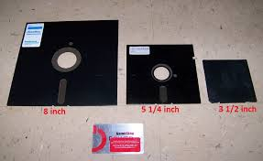
Secondary Storage - continued
8 inch Floppy = 80 kilobytes
5 ¼ = 360 kilobytes
3 ½ = 1.44 megabytes

Slide 28
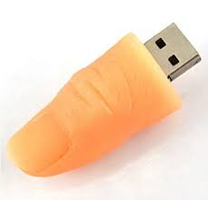
Secondary Storage continued
Thumb drive

Slide 29
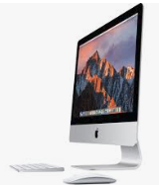
Peripherals
Any device that can be connected to a computer
  Monitor
  Mouse
  Keyboard
  Printer
All-IN-ONE
  iMAC

Slide 30
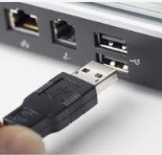
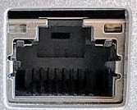
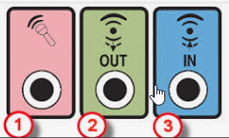
Current Connectors
Universal Serial Bus (USB)
  127 Devices
Ethernet Port
  Connect to network equipment
Audio Ports

Slide 31
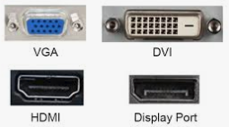
Current Connectors Continued
Monitor Ports
  VGA
  DVI
  HDMI
  Display

Slide 32
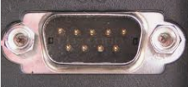


Legacy Connectors
Serial
  Connect Modems
  Connect to Network Equipment
Parallel Ports
  Printers
    Dot Matrix, Laser, Inkjet
SCSI (Small Computer Systems Interface)
  Connect Multiple Peripherals at one time
    Storage
    Backup Drives

Slide 33
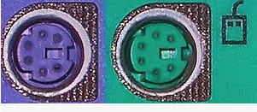
Legacy Connectors continued
PS2 Ports

Slide 34
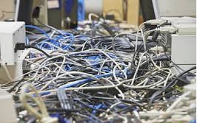
Issues with connectors

Slide 35


A new way to connect
When did it come out?
1998

Slide 36
1-3 What is computer software
Types of Software
  System Software (Windows or Linux or IOS)
  Application Software (Microsoft Office, MS-Paint)

Slide 37

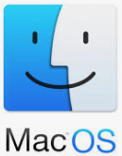



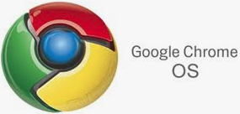
System software
Types of System Software
  Operating System
    Windows (PC, Tablet)
    Linux (PC)
    IOS (Tablet, Phone)
    Android (Tablet, Phone)
    MAC OSX (Apple Laptops and Desktops)
    Google Chrome (Chromebooks)

Slide 38
System Software - Linux
  Linux Pro’s
    Free
    Install on almost anything
  Linux Con’s
    Sometimes need more knowledge to run and maintain
    Public support

Slide 39
System software – Who makes What?
Microsoft - Windows
Apple – MacOS \ IOS
Android
Linux – Ubuntu, CentOS
Google – Chrome OS

Slide 40
System Software - Windows
  Windows Pro’s
    Install on almost anything (ish)
    Well Supported
    Easy to use (ish)
  Windows Con’s
    Does not run on older hard as well as newer
    Not Free

Slide 41
Application software
Types
  Productivity Software
    Microsoft Office
    Quickbooks
  Graphics Software
    MS Paint
    Adobe Products
  Communication Software
    Email Clients
    Web Browsers

Slide 42
Application software continued
Types
  Home\Education and Entertainment Software
    Turbo Tax
    Video Games

Slide 43
Application software continued
Custom Software
  Specialized software to perform specific task
Off the Shelf Software

Slide 44
Summary
What is a Computer
What is the IPC
What are the 4 components of the IPC
What are examples of the 4 components of the IPC
What are Bits and Bytes
Name Hardware Components
What is the difference between Primary and Secondary memory

Slide 45
Summary Continued
What is the difference between system and application software
What type of software do you use mostly

